Slide 1







Patient Experience And Reflective Learning (PEARL)
UK Critical Care Research Forum 2017
Friday 9th June 2017
Lenard Deacon Lecture Theatre, Medical School at the University of Birmingham
PEARL is funded by the HSDR Programme Ref 14/156/23
Olivia Brookes, PEARL Project Manager
On behalf of the PEARL collaborators
Notes:
Add Warwick and UCL

Slide 2
The PEARL Project: Overview
3 year developmental project recently launched
Funded by NIHR HS&DR Programme commissioned call on the use of patient experience data
Deliverable: A reflective learning framework for staff in acute care to improve patient and family experience.
Location: AMUs & ICUs
Some PE data already available
High-risk environment heightens sensitivity to behaviours
Units familiar with data collection
Endorsed by:
UK Critical Care Leadership Forum (23 national organisations)
Society of Acute Medicine

Slide 3
Background: Why PEARL?
Patient experience can be improved:
Lots of PE data, but little evidence for how this improves care (Picker)
Only 60% patients satisfied with NHS (NHS user survey 2016)
30% of complaints linked to issues in compassion, communication
Grief to grievance: NHS litigation £1.4Bn in 2014
Serious failures: Mid Staffs; Morecambe Bay
Personal accounts: There were disturbing deficits in communication, uncoordinated care, and occasionally an apparently complete absence of empathy. I recognized myself in every failure. (USA) A View from the Edge — Creating a Culture of Caring. Awdish RLA. NEJM Jan 2017
Staff experience can be improved:
NHS Staff Survey 2015
Supported by colleagues: 81%
Recommend Trust as place to work: 59%
Can make improvements happen at work: 56%
Valued by manager: 52%
Valued by organisation: 42%
Witnessed potentially harmful error: 25%
Bullying from manager/colleagues: 18%
Professional Training Programmes in ICM and Acute Medicine state that patient experience & reflective learning “at the heart of professional development”

Slide 4
PEARL: Aim
To improve outcomes for patients, families and staff by using patient and staff experience to enhance behavioural skills through…
Enhancing self-awareness
Emulating the best
Learning from failure
Developing a theory of workplace-based behaviour modification
Creating a Reflective Learning Framework as intervention for RCT

Slide 5
Design: 4 linked workstreams
Set-up:
Develop Programme Theory
Project teams in 3 Trusts: Executive/patients/clinicians
Local demographic data: PAS
Experiential Survey data:
Patients & relatives
Staff & trainees
Observational data: Ethnography
Topic guides linked to programme theory
Site visits
Workshops
Develop Reflective Learning Framework

Slide 6
Methods: PEARL Programme Theory
Links together sources of information from…
experiential survey data – patients, relatives, staff, trainees, MSF
direct observations by ethnographers
With current theories of…
behaviour (COM-B & Behaviour Change ‘Wheel’)
reflective learning
Converting thoughts to actions
(Daniel Kahneman: Thinking: fast, and slow)
Notes:
Daniel Kahneman ‘Thinking Fast, and Slow’: http://www.nytimes.com/2011/11/27/books/review/thinking-fast-and-slow-by-daniel-kahneman-book-review.html

Slide 7
Patient & Relative Experience Survey
16 items derived from:
NHS In-patient survey
NHS Friends & Family Test
Family Satisfaction in ICU (FS-ICU)
Picker Patient Experience Questionnaire
Questions phrased as statements
5-point agreement scale
Free text:
i) How could care be better?
ii) What did we do well?
Respondents:
AMU patients ≥24 h, ICU ≥48 h
Dissemination & implied consent
Unit discharge, or hospital discharge
Unit-specific quarterly reports:
Benchmarking
Nvivo analysis of free text

Slide 8
Staff & Trainee Experience Survey
Currently under development: Delphi method
Focus on:
working relationships, environment, attitudes to safety, use of patient experience, and to reflection
Items derived from existing surveys:
NHS Staff survey
Hospital Survey on Patient Safety Culture
Teamwork and Safety Climate Survey
Staff Friends & Family ‘Test’
Trainee doctor surveys: GMC/Deanery
PEARL Ethnography Topic Guides
COM-B and Theoretical Domains Framework
Questions phrased as statements
5-point agreement scale
Respondents: AMU and ICU clinical & managerial staff
Web-based annual survey

Slide 9
Ethnography University of Leicester SAPPHIRE Group
Phase 1: Programme Development
How are patient & staff experiences currently used?
Social aspects of behaviour modification
Feedback to design programme
Methods:
Workplace-based observations
Staff interviews (6-8 each site)
Patient & Relative Focus groups (6-8 participants each site)
Phase 2: Programme in action
Observe engagement with and uptake of reflective learning framework
Feedback to optimise utility
Methods:
Staff focus groups in each site
Observations of:
Workplace-based use of experiential data and reflective learning activities
Project workshops

Slide 10
MEASURES OF EXPERIENCE:
FS-ICU, Friends & Family Test (F&FT), Staff F&F Test, NHS Inpatient Survey, NHS Staff Survey, Multisource feedback, and other relevant clinical performance data
TACIT KNOWLEDGE
‘System 1’
‘Unconscious incompetence’
‘Unconscious competence’
Reflection on action
CLINICAL PRACTICE
Reflection in action
Retrospection
BEHAVIOUR
Suboptimal:
Aim to improve
GROUP WORK
BEHAVIOUR
Exemplary:
Aim to sustain
Self-evaluation
Reorientation
‘Conscious incompetence’
‘Conscious competence’
EXPLICIT KNOWLEDGE
‘System 2’
Capability, Opportunity, Motivation:
Barriers to and facilitators of behaviour change
OBSERVATIONS OF BEHAVIOUR:
Ethnography to inform intervention design
Notes:
Patient Experience And Reflective Learning (PEARL) programme theory
PEARL requires that the experiences of patients, families and staff, and relevant clinical performance data, are collected and fed-back to staff in the Intensive Care Units (ICUs) and Acute Medical Units (AMUs) in a manner that fosters interprofessional reflective learning at group and individual level to optimise clinician behaviour and thereby the experiences of patients, families and staff.
Experiential information will be derived from local and national surveys and multisource feedback. Relevant performance data may include critical incidents, complaints, timeliness of admission and discharge and data from the GMC trainee survey. Workplace observations of behaviour will be obtained through social scientists (ethnographers) undertaking direct observations in the clinical environment and through staff enquiry. The ethnographers will also explore barriers to and facilitators of patient-centred behaviours. This source material will be aggregated by the ICU and AMU local project teams (senior and junior clinical staff, patients and relatives, and managers) for group discussion before wider dissemination to all staff in the units.
The project therefore brings together theories of behaviour change with theories of reflective learning. We will integrate two theoretical models: one on behavioural theory relating to engagement of the staff in the whole process of reflection in social groups that lies at the heart of our proposal; the other specific to reflective learning.
Behavioural theory: A recent review [Michie 2014] of nineteen behaviour change frameworks has assimilated them in the form of the Behaviour Change Wheel, at the heart of which is ‘COM-B’: Capability, Opportunity and Motivation as drivers of Behaviour. We will use COM-B as our diagnostic instrument to evaluate staff engagement in reflective learning, focusing on barriers to and facilitators of such engagement. Barriers and facilitators include capabilities (e.g.: difficulty making time because of irregular service demands), opportunities (e.g.: the social milieu may be unfavourable) and motivation (e.g.: staff feel intuitively resentful at the implication that they are not good communicators). Engagement is a necessary but insufficient condition for the program to succeed; engagement must also be accompanied by effective reflective learning.
Reflective learning theory: Models of reflection involve three fundamental processes in knowledge development: retrospection, self-evaluation and reorientation [Quinn 1988], presented as a four-stage cycle by Kolb [Kolb 1984]. Our programme theory takes into account the notion that the knowledge which we will seek to develop is largely tacit. The theory of tacit knowledge has developed in recent years with much empirical support. Of considerable relevance to the PEARL project, it has been shown that tacit knowledge can beget explicit knowledge [Nonaka 2009]. The corollary is that we expect to find that participants are increasingly able to find language to describe at least some aspects of the knowledge they acquire, thereby reducing the cost of communicating with peers [Smith 2001]. However, the conversion of tacit to explicit knowledge is a two-way street, so explicit knowledge can eventually be internalised; unconscious incompetence becoming conscious competence and then unconscious competence. Tacit and explicit knowledge mirror Kahneman’s System 1 and System 2 thinking respectively.
Process and Context: A feature of tacit knowledge is that it is often acquired in a social context – part of social cognitive theory [Bandura 1977]. This is crucial to the design of our intervention, since the learning sessions will involve a group process. Certain members of the group may have sapiential authority which can be used to strengthen or weaken participation in the group [Bion 1943]; the ethnographer will be alert to the possibilities of positive and negative re-enforcement in this setting. The idea of reflection is integral to the development of tacit knowledge and its conversion, where feasible, to explicit knowledge: theoretically reflection is most powerful when it is part of a group displaying a positive attitude. Reflection is also more effective when undertaken as a shared, rather than an individual activity [Aronson 2011]. Participants will be encouraged to go beyond identifying an alternative plan for similar future situations and identifying reasons for the particular outcome, to a process in which underlying beliefs, frameworks and power relationships are questioned and thus incorporated into reoriented action plans [Aronson 2011].
Outputs: the Reflective Learning Framework: We hypothesise that individuals will move from reflection on action during group work to reflection in action as they provide patient care [Schon 1983]. Evidence suggests that feedback and reflection are most effective when combined into a single intervention [Anseel 2009]. We will assist staff in the ICUs and AMUs to develop an integrated approach to feedback and reflection [Sargeant 2009], taking into account the impact of techniques of feedback [Smither 2005; Van Manen 1991]. Participants will also be helped to distinguish between probabilities and values, between knowing how to reach objectives and in selecting which objectives to prioritise.
We do not wish to over-specify the way in which these interactions occur, for two reasons. First, implicit knowledge (allied to Schön’s concept of ‘professional artistry’ [Finlay 2008]) is likely to play an important part in the development of the framework; and second, we will use an adaptive process to modify the programme theory in the light of experience as the project proceeds. Local project teams will be asked to keep in mind the twin overarching objectives, of helping staff learn how to maximise patient and family psychological welfare and to become more zealous of doing so.
References
Anseel, F., F. Lievens, and E. Schollaert, Reflection as a strategy to enhance task performance after feedback. Organizational Behavior and Human Decision Processes, 2009. 110(1): p. 23-35.
Aronson, L., Twelve tips for teaching reflection at all levels of medical education. Medical teacher, 2011. 33(3): p. 200-205.
Bandura A. Social Learning Theory. Englewood Cliffs, NJ: Prentice Hall, 1977
Bion, W.R. (1943). Intra-group tensions in therapy, Lancet 2: 678/781 - Nov.27, 1943
Business Balls. Conscious competence learning model. 2015 29/04/2015]; Available from: http://www.businessballs.com/consciouscompetencelearningmodel.htm.
Kolb, D.A., Experiential learning: Experience as the source of learning and development. 1984, Englewood Cliffs: Prentice Hall.
Finlay, L., Reflecting on ‘Reflective practice’. Accessed March, 2008. 29: p. 2014.
Michie, S., M.M. van Stralen, and R. West, The behaviour change wheel: a new method for characterising and designing behaviour change interventions. Implementation Science, 2011. 6(1): p. 42.
Nonaka I, & von Krogh GT. Tacit Knowledge and Knowledge Conversion: Controversy and Advancement in Organizational Knowledge Creation Theory. Organ Sci. 2009; 20(3): 635-52.
Quinn, F.M., Reflection and reflective practice, in Changing practice in health and social care, L. Finlay and A. Bullman, Editors. 1988, Sage: London.
Sargeant, J.M., et al., Reflection: a link between receiving and using assessment feedback. Advances in health sciences education, 2009. 14(3): p. 399-410.
Smither, J.W., M. London, and R.R. Reilly, Does performance improve following multisource feedback? A theoretical model, meta‐analysis, and review of empirical findings. Personnel Psychology, 2005. 58(1): p. 33-66.
Schon, D., The reflective practitioner: How professionals think in action. 1983, London: Temple Smith.
Smith EA. The role of tacit and explicit knowledge in the workplace. J Knowl Manag. 2001; 5(4): 311-21
Van Manen, M., Reflectivity and the pedagogical moment: the normativity of pedagogical thinking and acting 1. J. Curriculum Studies, 1991. 23(6): p. 507-536.

Slide 11
MEASURES OF EXPERIENCE:
FS-ICU, Friends & Family Test (F&FT), Staff F&F Test, NHS Inpatient Survey, NHS Staff Survey, Multisource feedback, and other relevant clinical performance data
TACIT KNOWLEDGE
‘System 1’
‘Unconscious incompetence’
‘Unconscious competence’
Reflection on action
CLINICAL PRACTICE
Reflection in action
Retrospection
BEHAVIOUR
Suboptimal:
Aim to improve
GROUP WORK
BEHAVIOUR
Exemplary:
Aim to sustain
Self-evaluation
Reorientation
‘Conscious incompetence’
‘Conscious competence’
EXPLICIT KNOWLEDGE
‘System 2’
Capability, Opportunity, Motivation:
Barriers to and facilitators of behaviour change
OBSERVATIONS OF BEHAVIOUR:
Ethnography to inform intervention design
Notes:
Preliminary programme theory:
Measures of experience will be collected through the two different stakeholder surveys
This will be combined with observations of behaviour from our ethnographic work
From this we will derive an understanding of the barriers and facilitators of behaviour change
We will do this using the COM-B framework which describes behaviour in terms of ‘Capability’, ‘Opportunity’ and ‘Motivation’
Suboptimal behaviours will be identified that we aim to improve
Exemplary behaviours will also be seen which we aim to sustain
Suboptimal behaviours will be difficult and challenging to deal with and we see this being done initially at the group level – reflection on action
The exemplars of best practice we expect to be visible in daily clinical practice through reflection in action
We see this process occurring through 4 stages of consciousness
Initially we may be unaware of our behaviours which are susceptible to improvement (unconscious incompetence)
These behaviours are to be brought to our conscious awareness (conscious incompetence)
Through collaborative practice behaviour will be modified (conscious competence)
Overtime , these behaviours will be normalised and form part of our conscious competence
With believe this dialogue requires two ways of converting thought to action:
System 1, Fast Thinking, Tacit knowledge – Fast, unconscious, intuitive
System 2, Slow Thinking, Explicit knowledge – Slow, reflective
This is supported by our theory of reflection outlining the need for ‘retrospection’, ‘self-evaluation’ and ‘reorientation’

Slide 12
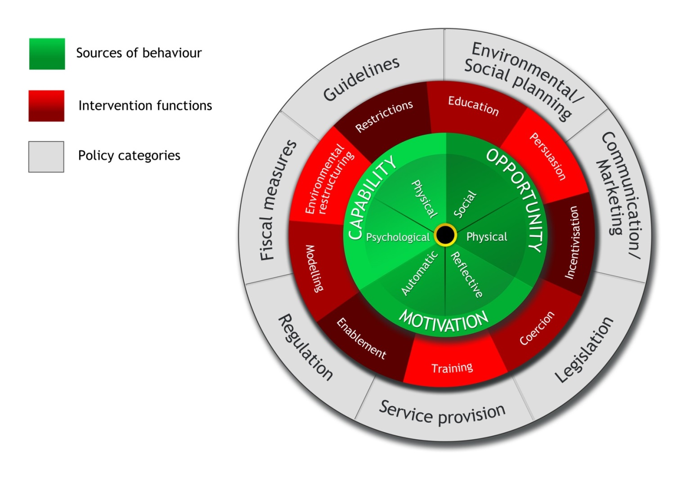
From Analysis to Action: The Behaviour Change Wheel
Incorporating 19 behaviour change theories
Michie et al. Implementation Science 2011, 6:42

Slide 13
What’s the product? Reflective learning framework
A tool for behaviour modification
Likely format - a ‘toolkit’:
Resources, guidance, techniques, stories, audits, humour, sanctions & challenges, ’Doc-Advisor’, ‘rate my driving’; video-reflective ethnography, interactive technologies with avatars...
Focus: to improve patient, family and staff wellbeing
A dynamic instrument
Iterative small cycle testing by the local project teams
Locally ‘owned’ and ‘normalised’ in daily practice
Potential for subsequent testing in a Cluster Step-Wedge RCT
And if so, how we would know it ‘worked’?

Slide 14
Thank you
PEARL Collaborators:
Prof Julian Bion, Olivia Brookes, Duncan Buckley, Lisa Marie Buckley, Dr Carolyn Tarrant, Dr Janet Willars, Prof Gavin Perkins, Dr Celia Taylor, Prof Richard Lilford, Dr Paul Sullivan, Kazi Zawad, Felicity Evison, Dr Julian Archer, Dr Lou Atkins, Prof Ivo Vlaev, Dr Yen-Fu Chen, Stephen Perks
UHB Project Team:
Dr Randeep Mullhi
Dr Catherine Snelson
Tim Jones
Jake Osborne-Wylde
Emma Reeves
Amy Bamford
Mr & Mrs Andrew Cox (PPI)
Luke Flavell (PPI)
Jackie Flavell (PPI)
Tim Marshall (PPI)
Dr Caroline Higenbottam
Dr Greg Packer
Elaine Tracey
Cait Nee
Sarah Vince
Leah Duffy
HEFT Project Team:
Prof Fang Gao Smith
Dr Trishna Chakravorty
Karen Kneller
Shane Butlin (PPI)
Ralph Arnold (PPI)
Dr Lucie Linhartova
Dr Nitin Arora
Jane Story
Jill French
Dr Marwa Mattar
Lois Houlders
Andrew Coughlan
Gill Randall
Julia Sampson
Teresa Melody
NUTH Project Team:
Prof Kath McCourt
Dr Stephen Wright
Claire Randell
Dr Ian Clement
Ingrid O'Neil
Gill Yeoman
Dr Chris Gibbins
Helena Korovessis
Dr Jonathan Shelton
Isabel Barrow
Carmen Scott
Neil Alderson
Christine Straughan Katherine Cullen
Andrew Pike
Dr Louise Swan
Dr Kay Protheroe
Dr Helen Doherty
Ian Spencer (PPI)

Slide 15
We would appreciate your feedback on:
How this project might be received by your ICU
What ‘support materials’ might best foster reflective learning
Possible formats for these support materials – the nature of the reflective learning framework
Potential for a cluster-randomised trial of the intervention, once developed

